Slide 1

RESEARCH CENTRE FOR INTEGRATED MICROSYSTEMS – UNIVERSITY OF WINDSOR
M.A.Sc. Proposal Seminar
“Design and Evaluation of Embedded CPU Cores for FPGAs”
By: Ian D. L. Anderson, M.A.Sc Candidate
Supervisor: Dr. Mohammed A. S. Khalid
Date: October XX, 2005
University of Windsor
Department of Electrical and Computer Engineering
Ian Anderson
First M.A.Sc. Seminar
Slide 1

Slide 2
Seminar Outline
RESEARCH CENTRE FOR INTEGRATED MICROSYSTEMS – UNIVERSITY OF WINDSOR
1. Introduction
2. The Problem
3. Proposed Research Goals
4. Previous Work & State-of-the-Art
5. Summary
6. References
Ian Anderson
First M.A.Sc. Seminar
Slide 2

Slide 3
Introduction:
RESEARCH CENTRE FOR INTEGRATED MICROSYSTEMS – UNIVERSITY OF WINDSOR
The Background & Context of this Research
Ian Anderson
First M.A.Sc. Seminar
Slide 3

Slide 4
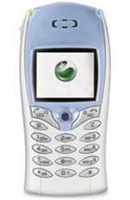
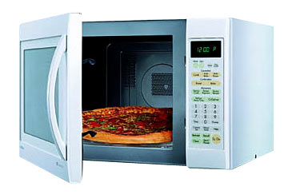
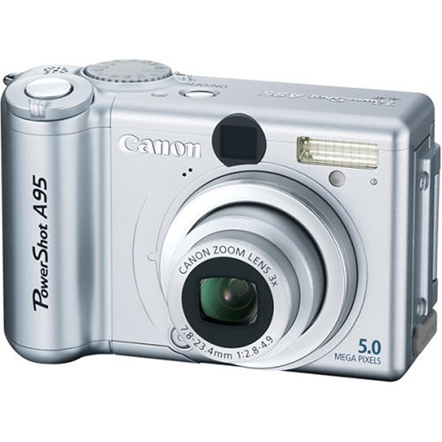
Embedded Systems
RESEARCH CENTRE FOR INTEGRATED MICROSYSTEMS – UNIVERSITY OF WINDSOR
An application-specific electronic sub-system used within a larger system (e.g. Cars, appliances, etc.)
Designed to carry out only a small range of tasks specific to a particular application
  Contrast this with a general-purpose computer
Ian Anderson
First M.A.Sc. Seminar
Slide 4

Slide 5
RESEARCH CENTRE FOR INTEGRATED MICROSYSTEMS – UNIVERSITY OF WINDSOR
Major components of an embedded system:
Digital hardware:
  A microprocessor or microcontroller
  Application-specific
  hardware generally
  used for accelerating
  time-critical tasks
Embedded software:
  A sequence of instructions given to the microprocessor to carry out
Embedded System
Embedded CPU
Software running
on CPU
Memory
& I/O
Application-
specific
hardware
Ian Anderson
First M.A.Sc. Seminar
Slide 5

Slide 6
Design of Embedded Systems
RESEARCH CENTRE FOR INTEGRATED MICROSYSTEMS – UNIVERSITY OF WINDSOR
System Specification
Traditional approach: Design
system hardware first, then
write software
Co-design approach:
Consider hardware
and software
design concurrently
  Known as hardware/
  software co-design
General co-design flow:
Hardware/Software Partitioning
Hardware Design
HW/SW Interface Design
Software Development
Hardware Synthesis
Compiler
Placement & Routing
Assembler/
Linker
Integration & Testing
Final Embedded System
Ian Anderson
First M.A.Sc. Seminar
Slide 6

Slide 7
Intellectual Property (IP) Cores
RESEARCH CENTRE FOR INTEGRATED MICROSYSTEMS – UNIVERSITY OF WINDSOR
Complexity of embedded systems increased as markets for them expanded
  Designing a system from scratch soon became too expensive and time consuming for many designers
The alternative: use pre-designed and pre-tested hardware and software components to build complete designs
Components known as “Intellectual Property (IP) cores”
Ian Anderson
First M.A.Sc. Seminar
Slide 7

Slide 8
RESEARCH CENTRE FOR INTEGRATED MICROSYSTEMS – UNIVERSITY OF WINDSOR
There are now IP cores available for virtually any application
Examples:
  General-purpose processors – IBM PowerPC, Nios, etc.
  DSPs – Altera DSP MegaCores for FFTs, filtering, etc.
  Peripherals – RS-232 UART, USB, timers, etc.
Three types of IP cores:
  Hard cores: Components that are pre-placed & pre-routed for a particular IC technology
  Firm cores: Pre-synthesized gate-level netlists
  Soft cores: Components described using a Hardware Description Language (HDL) such as VHDL or Verilog
Ian Anderson
First M.A.Sc. Seminar
Slide 8

Slide 9
RESEARCH CENTRE FOR INTEGRATED MICROSYSTEMS – UNIVERSITY OF WINDSOR
Soft-core Processors
Complete microprocessors described in an HDL
Many are “parameterizable” – they feature configurable options or “parameters” that can be set at design time
Some advantages:
  Designers can tailor the processor to more closely fit the intended application
  Platform independent
  More immune to obsolescence
Ian Anderson
First M.A.Sc. Seminar
Slide 9

Slide 10


RESEARCH CENTRE FOR INTEGRATED MICROSYSTEMS – UNIVERSITY OF WINDSOR
Most popular soft-core processors:
  Altera Corporation: Nios (and its successor, the Nios II)
  Xilinx Inc.: MicroBlaze and PicoBlaze
Each feature a large set of customizable parameters and peripherals
Others: Tensilica Xtensa, open-source cores like LEON 2 and 3, OpenRISC, etc.
Image source: Nios 32-bit Programmers Reference Manual
Image source: http://www.em.avnet.com/evk/home/
Ian Anderson
First M.A.Sc. Seminar
Slide 10

Slide 11
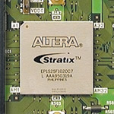
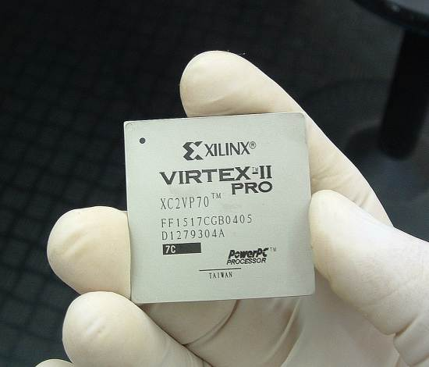
RESEARCH CENTRE FOR INTEGRATED MICROSYSTEMS – UNIVERSITY OF WINDSOR
FPGA Technology
Field Programmable Gate Arrays (FPGAs) are devices that can be (re)programmed to act like any digital circuit design
They can provide a flexible prototyping and implementation medium for embedded systems
Image source:
www.radiancetech.com/images
Image source: www.dcecom.de/images
Ian Anderson
First M.A.Sc. Seminar
Slide 11

Slide 12
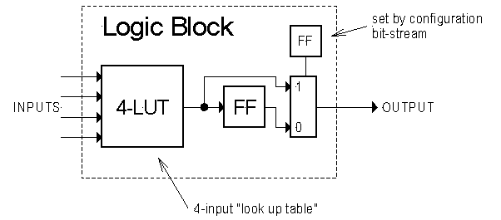
RESEARCH CENTRE FOR INTEGRATED MICROSYSTEMS – UNIVERSITY OF WINDSOR
FPGAs feature programmable logic elements (LE's)
  Commonly include a look-up-table (LUT) and a flip-flop (FF) for implementing sequential logic
Example of an generalized LUT-based LE:
Image source: http://www-inst.eecs.berkeley.edu/~cs150/sp00/classnotes/u6.1/6_1_3.html
Ian Anderson
First M.A.Sc. Seminar
Slide 12

Slide 13
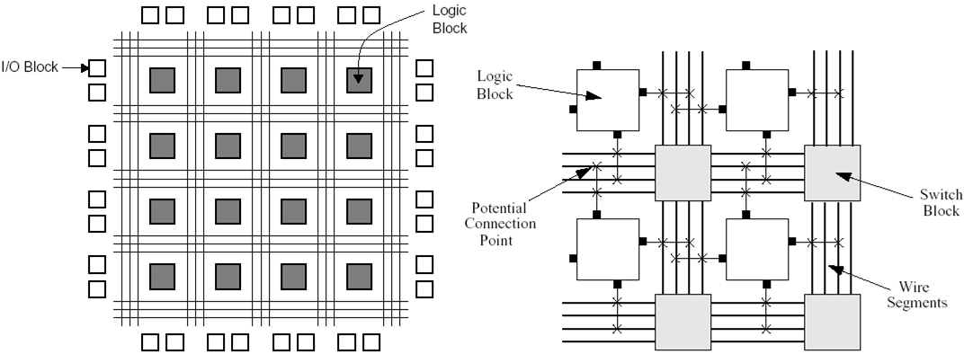
RESEARCH CENTRE FOR INTEGRATED MICROSYSTEMS – UNIVERSITY OF WINDSOR
FPGAs also include programmable interconnects (a.k.a. “routing”) between LE's:
Ian Anderson
First M.A.Sc. Seminar
Slide 13

Slide 14

The Problem:
RESEARCH CENTRE FOR INTEGRATED MICROSYSTEMS – UNIVERSITY OF WINDSOR
Motivation for Upcoming Work
Ian Anderson
First M.A.Sc. Seminar
Slide 14

Slide 15
Processor Design for FPGAs
RESEARCH CENTRE FOR INTEGRATED MICROSYSTEMS – UNIVERSITY OF WINDSOR
Full custom and ASIC design of processors has been well explored over last few decades
FPGAs are a relatively new technology, so designing processors targeting them is still an open area of research
The Big Question: How is processor design for FPGAs different than that of full custom VLSI and ASIC design?
Ian Anderson
First M.A.Sc. Seminar
Slide 15

Slide 16
RESEARCH CENTRE FOR INTEGRATED MICROSYSTEMS – UNIVERSITY OF WINDSOR
CPU design for FPGAs certainly differs from that of full custom and ASIC design:
  More forgiving – if a mistake in the design is made, the FPGA can simply be reprogrammed
  A more iterative design approach is possible
  Hardware design can sometimes resemble software development
  Some CPU architectures that work well in full custom or ASIC design may not work well in FPGAs
Ian Anderson
First M.A.Sc. Seminar
Slide 16

Slide 17
RESEARCH CENTRE FOR INTEGRATED MICROSYSTEMS – UNIVERSITY OF WINDSOR
Underlying Motivation
We would be interested to have a more complete knowledge of what CPU architectures, tools and techniques work well for FPGAs specifically
Our primary motivation:
  To produce better, faster, more efficient embedded systems for FPGAs
  To do it in less time and with less design cost
We can do this by learning to exploit the features of programmable technology more effectively in the process of designing CPUs
Ian Anderson
First M.A.Sc. Seminar
Slide 17

Slide 18

RESEARCH CENTRE FOR INTEGRATED MICROSYSTEMS – UNIVERSITY OF WINDSOR
Proposed Research Goals:
An Exploration of the Soft-core Processor Design Space for FPGAs
Ian Anderson
First M.A.Sc. Seminar
Slide 18

Slide 19
RESEARCH CENTRE FOR INTEGRATED MICROSYSTEMS – UNIVERSITY OF WINDSOR
Overall Objectives
Main objective: To gain a greater understanding of how soft-core processor design targeting FPGAs is unique in terms of:
  Processor architectures
  Tools
  Design techniques and methodologies
Investigate and evaluate several soft-core CPU architectural alternatives to determine what works well on an FPGA
Ian Anderson
First M.A.Sc. Seminar
Slide 19

Slide 20
Research Strategy
RESEARCH CENTRE FOR INTEGRATED MICROSYSTEMS – UNIVERSITY OF WINDSOR
Three phase research strategy is proposed:
Phase 1: Develop a
Soft Processor
Design to use as a Template
Phase 2:
Generate Processor Variants
From the Template Design
Phase 3: Implementation, benchmark testing and processor evaluation
Ian Anderson
First M.A.Sc. Seminar
Slide 20

Slide 21
RESEARCH CENTRE FOR INTEGRATED MICROSYSTEMS – UNIVERSITY OF WINDSOR
Phase 1: Develop a parameterizable soft-core processor to use as a template design
  Create a soft-core processor in VHDL based on an existing instruction set architecture (ISA)
  ISA selected based on:
    Availability of a pre-existing C compiler
    Relative simplicity
    Representative of embedded applications
  Processor will be used as a template for generating “variant” CPUs with different architectural parameters
Ian Anderson
First M.A.Sc. Seminar
Slide 21

Slide 22
RESEARCH CENTRE FOR INTEGRATED MICROSYSTEMS – UNIVERSITY OF WINDSOR
Phase 2: Generate processor variants
  Add numerous architectural parameters to the template CPU design, for example:
    Different pipeline architectures
    Various cache schemes
    Several ALU functional unit implementations
  Generate variant CPUs with different architectural parameters selected
  Develop a tool that enables users to rapidly select parameters and generate variants
  Variants used to explore the CPU design space for FPGAs
Ian Anderson
First M.A.Sc. Seminar
Slide 22

Slide 23
RESEARCH CENTRE FOR INTEGRATED MICROSYSTEMS – UNIVERSITY OF WINDSOR
Phase 3: Implementation and benchmark testing
  Implement CPU variants one or more different FPGAs (Stratix and Virtex FPGAs)
  Run a set of benchmarks on the CPUs, including:
    Dhrystone
    MiBench Benchmark suite
    Others (yet to be selected)
  Evaluate the variants in terms of performance and area cost
  Attempt to draw some conclusions about the architectural features of CPUs that work best on an FPGA platform
Ian Anderson
First M.A.Sc. Seminar
Slide 23

Slide 24

Previous Work & State-of-the-Art
RESEARCH CENTRE FOR INTEGRATED MICROSYSTEMS – UNIVERSITY OF WINDSOR
Ian Anderson
First M.A.Sc. Seminar
Slide 24

Slide 25
Soft-Core Processors
RESEARCH CENTRE FOR INTEGRATED MICROSYSTEMS – UNIVERSITY OF WINDSOR
Examples of commercial cores available:
  Altera: Nios and Nios II
  Xilinx: MicroBlaze and PicoBlaze
These cores are usually shipped with their associated suite of CAD tools
Also, there are many open-source processing cores available on the internet
  E.g. www.opencores.org, LEON2 and 3, UT Nios, etc.
Ian Anderson
First M.A.Sc. Seminar
Slide 25

Slide 26
Altera Nios
RESEARCH CENTRE FOR INTEGRATED MICROSYSTEMS – UNIVERSITY OF WINDSOR
Nios is a general purpose pipelined RISC processor
Features a large number of configurable parameters including:
  Datapath width, register file size, multiplier support, optional caches, etc.
  Custom instruction support, peripheral buses
Ian Anderson
First M.A.Sc. Seminar
Slide 26

Slide 27

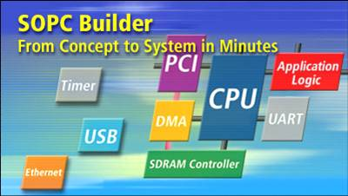
RESEARCH CENTRE FOR INTEGRATED MICROSYSTEMS – UNIVERSITY OF WINDSOR
Quartus II is a complete design environment targeting Altera FPGAs
Includes tools for:
  Design entry using VHDL, Verilog
  or AHDL
  Logic synthesis, placement & routing
  Timing analysis, design verification
  FPGA programming
Also includes SOPC Builder,
which allows designers to
rapidly build systems
  Ex. Nios system w/ peripherals
Ian Anderson
First M.A.Sc. Seminar
Slide 27

Slide 28

Altera Nios II
RESEARCH CENTRE FOR INTEGRATED MICROSYSTEMS – UNIVERSITY OF WINDSOR
Successor of the original Nios
Comes in three major variants:
  Nios II/e – the economy core
  Nios II/s – the standard core
  Nios II/f – the fast core
Also includes support for up to 256 custom instructions
Can be used with SOPC Builder to create complete Nios II systems
Ian Anderson
First M.A.Sc. Seminar
Slide 28

Slide 29
Xilinx MicroBlaze
RESEARCH CENTRE FOR INTEGRATED MICROSYSTEMS – UNIVERSITY OF WINDSOR
A 32-bit soft-core processor for embedded applications
Features: Harvard RISC architecture, 3 stage pipeline, 32 registers, ALU, shift unit, two levels of interrupt
Optionally:
  IEEE-754 compatible floating
  point unit (FPU)
  Barrel shifter
Ian Anderson
First M.A.Sc. Seminar
Slide 29

Slide 30
RESEARCH CENTRE FOR INTEGRATED MICROSYSTEMS – UNIVERSITY OF WINDSOR
  Data and instruction caches
  Exception handling
  Debug logic, etc.
Virtex and Spartan series FPGAs only
Also includes the Embedded Development Kit (EDK), which features Xilinx Platform Studio
Ships with a collection of IP cores necessary to create embedded systems with MicroBlaze
Ian Anderson
First M.A.Sc. Seminar
Slide 30

Slide 31
Relevant Academic Research
RESEARCH CENTRE FOR INTEGRATED MICROSYSTEMS – UNIVERSITY OF WINDSOR
SPREE (P. Viannacouras) - Consists of an RTL Generator and a Component Library for generating CPUs
Used to explore FPGA-based soft-core design space:
  Software vs. hardware multiplication
  Pipelining tradeoffs - # of stages, fowarding, etc.
  Functional unit implementations (e.g. fully serial ALU)
  Instruction set subsetting
Some conclusions made using SPREE:
  Hardware multiplication better – implemented on Stratix fast DSP blocks
  More pipeline stages increases area but not always performance
  Significant area savings can be achieved with instruction set subsetting, although only modest performance gains
Ian Anderson
First M.A.Sc. Seminar
Slide 31

Slide 32
RESEARCH CENTRE FOR INTEGRATED MICROSYSTEMS – UNIVERSITY OF WINDSOR
UNUM (N. Dave and M. Pellauer)
  A framework of reusable components for design space exploration
  Used to model a single PowerPC processor
Exploration of Pipelined Embedded Processors (P. Mishra et al)
  ADL-based exploration framework for generating HDL models of pipelined processors
  Rapid exploration of the DLX architecture, including pipeline paths & stages and operation addition
Ian Anderson
First M.A.Sc. Seminar
Slide 32

Slide 33
Summary
RESEARCH CENTRE FOR INTEGRATED MICROSYSTEMS – UNIVERSITY OF WINDSOR
Processor design targeting FPGAs is different from that of full custom or ASIC
Interested in gaining a better understanding of FPGA-based soft processor design
Proposed a three-phase research strategy:
  (1) Develop soft-core processor as a template
  (2) Generate processor variants
  (3) Implement and evaluate variants using benchmarks
Ian Anderson
First M.A.Sc. Seminar
Slide 33

Slide 34
References
RESEARCH CENTRE FOR INTEGRATED MICROSYSTEMS – UNIVERSITY OF WINDSOR
[1] Ahmed A. Jerraya “Long term trends for embedded system design”, Proceedings of the EUROMICRO Systems on Digital System Design (DSD'04)
[2] Giovanni De Micheli and Rajesh K. Gupta, “Hardware/software co-design” Proceedings of the IEEE, Vol. 85, No. 3, March 1997
[3] Rajesh K. Gupta and Giovanni De Micheli, “Hardware-software cosynthesis for digital systems”, IEEE Design & Test of Computers, September 1993, Pg. 29- 41
[4] Rolf Ernst, Jörg Henkel and Thomas Benner “Hardware- software cosynthesis for microcontrollers”, IEEE Design & Test of Computers, December 1993, Pg. 64-75
Ian Anderson
First M.A.Sc. Seminar
Slide 34

Slide 35
RESEARCH CENTRE FOR INTEGRATED MICROSYSTEMS – UNIVERSITY OF WINDSOR
[5] Rolf Ernst, “Codesign of embedded systems: status and trends”, IEEE Design & Test of Computers, April-June 1998, Pg. 45-54
[6] Xilinx, Inc. Website, www.xilinx.com, July 2005
[7] Altera Corporation Website, www.altera.com, July 2005
[8] 1076a-2000, “IEEE VHDL standard language reference manual”, New York, N.Y., U.S.A., January 30, 2000
[9] 1364-2001, IEEE Verilog standard language reference manual”
[10] Altera Nios, http://www.altera.com/products/ip/processors/nios/nio- index.html, July 2005
Ian Anderson
First M.A.Sc. Seminar
Slide 35

Slide 36
RESEARCH CENTRE FOR INTEGRATED MICROSYSTEMS – UNIVERSITY OF WINDSOR
[11] Xilinx MicroBlaze, http://www.xilinx.com/xlnx/xebiz/designResources/ip_prod uct_details.jsp?key=micro_blaze, July 2005
[12] Gaisler Research Website, http://www.gaisler.com/, July 2005
[13] Opencores.org Website, http://www.opencores.org/, July 2005
[14] Altera Corporation, “Nios 3.0 CPU datasheet”, October 2004, Version 2.2
[15] Altera Corporation, “Nios embedded processor 16-bit programmer's reference manual”, January 2004, Version 3.1
Ian Anderson
First M.A.Sc. Seminar
Slide 36

Slide 37
RESEARCH CENTRE FOR INTEGRATED MICROSYSTEMS – UNIVERSITY OF WINDSOR
[16] Altera Corporation, “Nios embedded processor 32-bit programmer's reference manual”, January 2003, Version 3.1
[17] Nios II Website, http://www.altera.com/products/ip/processors/nios2/ni2- index.html, July 2005
[18] Altera Corporation, “Quartus II version 5.0 handbook”, May 2005, Version 5.0.0
[19] SOPC Builder, http://www.altera.com/products/software/products/sopc/so p-index.html, July 2005
[20] MicroBlaze Architecture, http://www.xilinx.com/ipcenter/processor_central/microblaz e/architecture.htm, July 2005
Ian Anderson
First M.A.Sc. Seminar
Slide 37

Slide 38
RESEARCH CENTRE FOR INTEGRATED MICROSYSTEMS – UNIVERSITY OF WINDSOR
[21] EDK – Embedded Development Kit and Platform Studio, http://www.xilinx.com/xlnx/xebiz/designResources/ip_prod uct_details.jsp?sGlobalNavPick=PRODUCTS&sSecondary NavPick=Design+Tools&key=DO-EDK, July 2005
[22] E-mail correspondence, Altera Corporation, July 6, 2005
[23] Peter Yiannacouras, “The Microarchitecture of FPGA- Based Soft Processors”, M.A.Sc Thesis, University of Toronto
[24] Nirav Dave and Michael Pellauer, “UNUM: A General Microprocessor Framework using Guarded Atomic Actions”, in Workshop on Architecture Research using FPGA Platforms in the 11th International Symposium on High-Performance Computer Architecture. IEEE Computer Society, 2005.
Ian Anderson
First M.A.Sc. Seminar
Slide 38

Slide 39
RESEARCH CENTRE FOR INTEGRATED MICROSYSTEMS – UNIVERSITY OF WINDSOR
[25] P. Mishra, A. Kejariwal, and N. Dutt, “Synthesis-driven Exploration of Pipelined Embedded Processors” in VLSI Design, 2004, pp. 921-926.
Ian Anderson
First M.A.Sc. Seminar
Slide 39

